Slide 1
Dictionaries in Python
Introduction to Python Dictionaries

Slide 2
What is a Dictionary in Python?
A dictionary is a collection of key-value pairs.
Unordered, changeable, and does not allow duplicates.
Syntax: {key: value, key: value, ...}

Slide 3

Accessing Dictionary Elements
Accessing values using keys.
Using get() method.

Slide 4
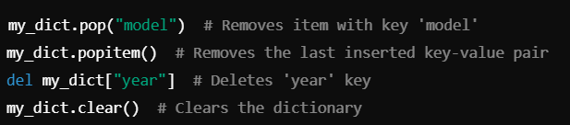

Dictionary Methods
Adding or Changing Items
Removing Items from a Dictionary
Adding new key-value pairs.
Modifying existing values.
pop(), popitem(), del, and clear() methods.

Slide 5
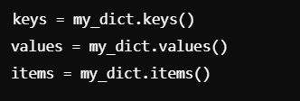
Dictionary Methods
keys(): Returns all keys.
values(): Returns all values.
items(): Returns key-value pairs.

Slide 6
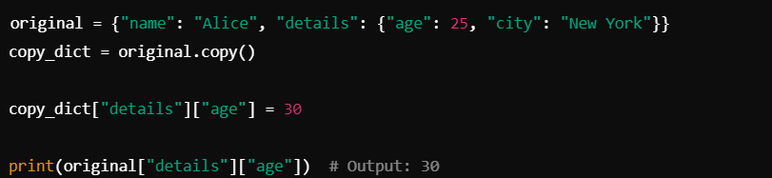
copy() Method
The copy() method creates a shallow copy of the dictionary.
A shallow copy means that it copies the dictionary structure, but if the values themselves are mutable objects (like other dictionaries or lists), the references to those objects are copied, not the objects themselves. So, modifications to the nested mutable objects in the copy will also affect the original dictionary.

Slide 7
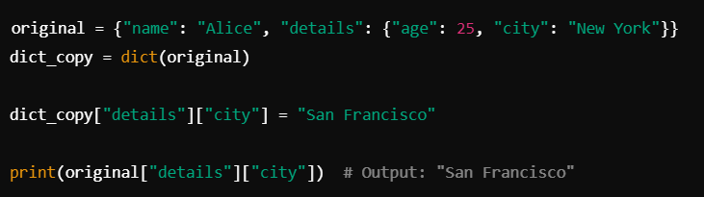
dict() Constructor
Using dict() also creates a shallow copy of the dictionary.
Internally, dict() re-creates a new dictionary using the key-value pairs of the original dictionary.
The behavior is almost identical to copy() in terms of copying the dictionary structure and references to mutable objects.

Slide 8
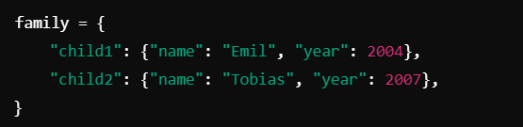
Nested Dictionaries
A dictionary within a dictionary.

Slide 9
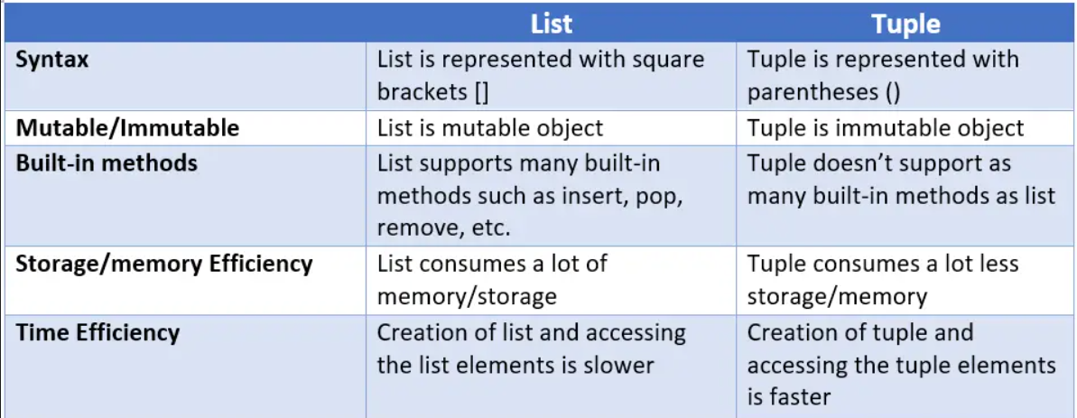
Difference between List and tuple

Slide 10
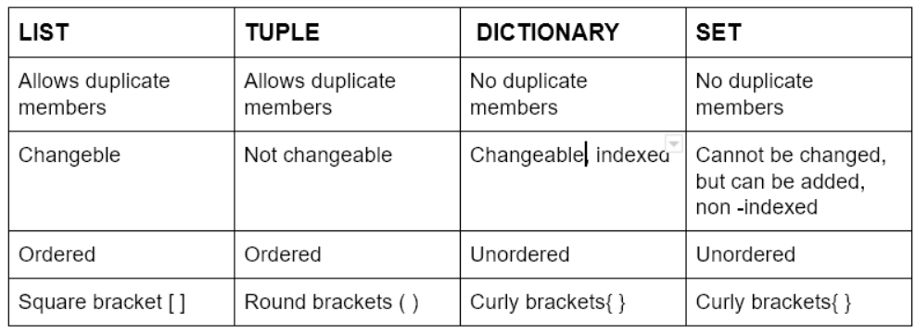
Comparision between all data structure

Slide 11
Thank You
Happy learning!

